Slide 1

Implementing and comparing the sorting algorithms
Merge Sort
Heap Sort
Quick Sort
Insertion Sort
Radix Sort

Slide 2
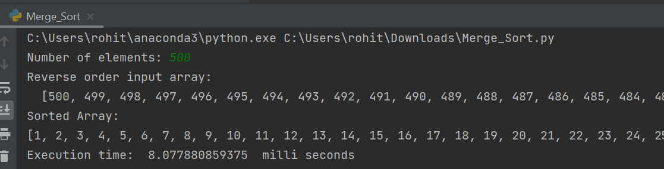
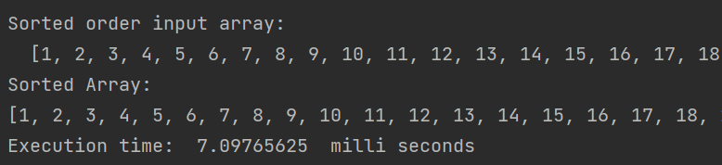
Merge sort
1) For Small Input Length (500)
When the input data is in reverse sorted order (Worst Case):
When the input data is in sorted order (Best case):

Slide 3
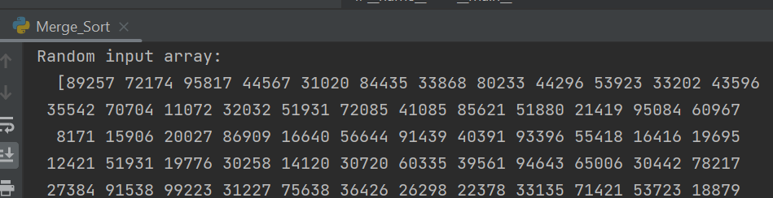
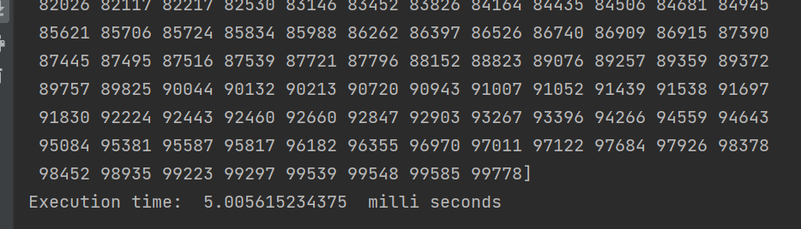
When the input data is in random order (Average Case):

Slide 4
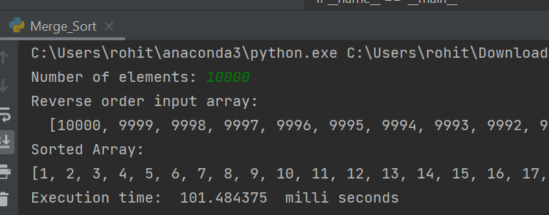
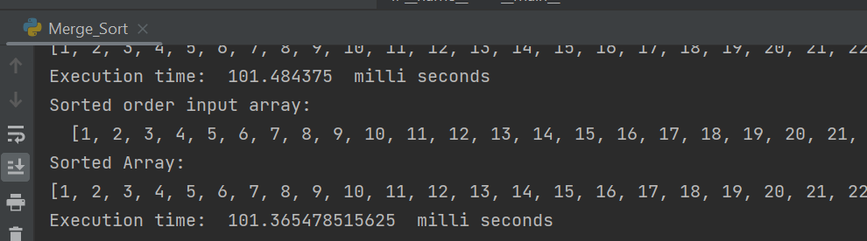
2) For Medium Input Length (10000)
When the input data is in reverse sorted order (Worst Case):
When the input data is in sorted order (Best case):

Slide 5
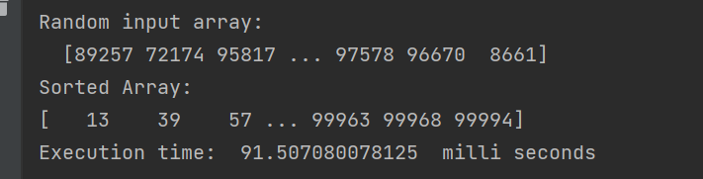
When the input data is in random order (Average Case):

Slide 6
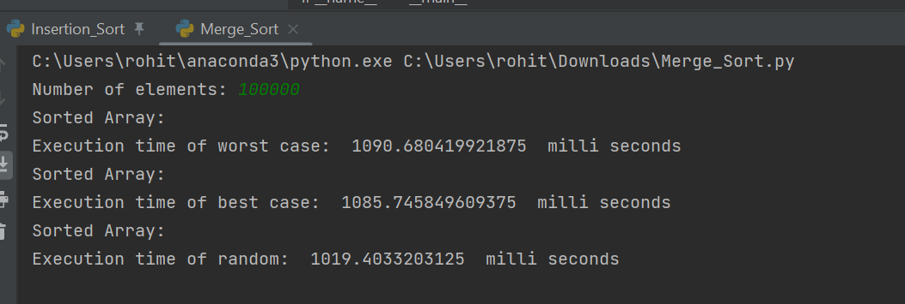
3) For Large Input Length (100000)

Slide 7
Average Time Of Execution
For small input (500), the average time of execution is 6.72 milli seconds.
For medium input (10000), the average time of execution is 98.11 milli seconds.
For large input (100000), the average time of execution is 1065.27 milli seconds.

Slide 8
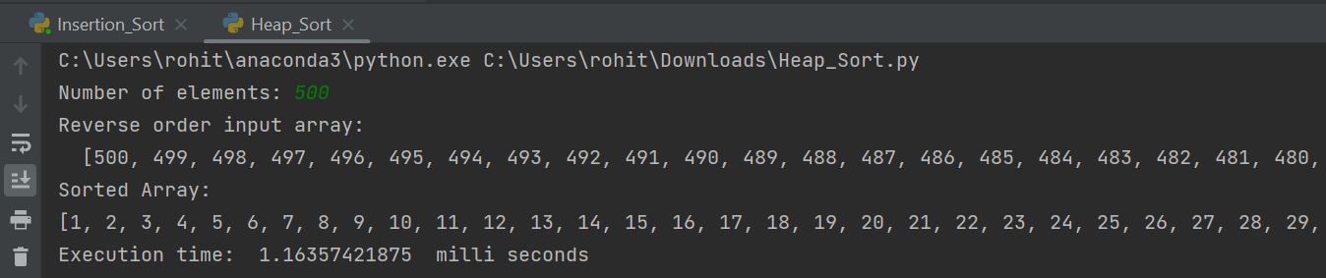
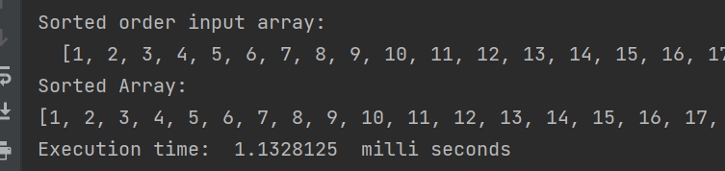
Heap sort
1) For Small Input Length (500)
When the input data is in reverse sorted order (Worst Case):
When the input data is in sorted order (Best case):

Slide 9
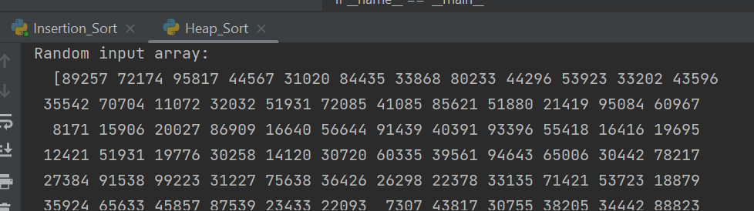
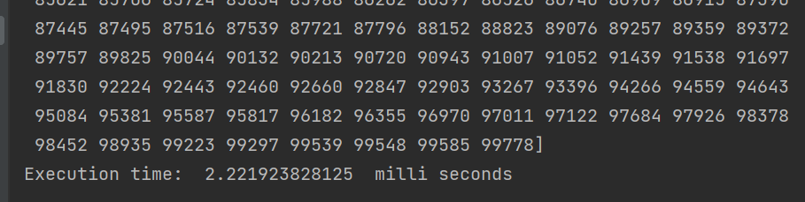
When the input data is in random order (Average Case):

Slide 10
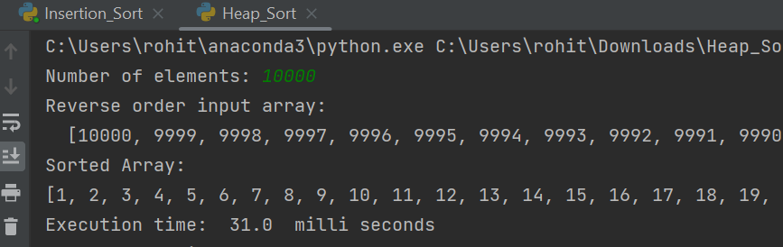
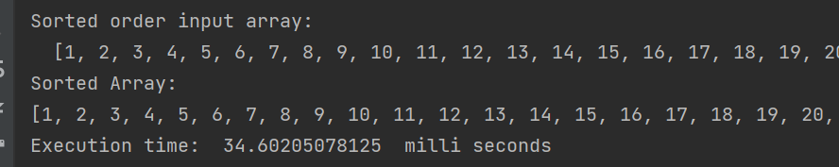
2) For Medium Input Length (10000)
When the input data is in reverse sorted order (Worst Case):
When the input data is in sorted order (Best case):

Slide 11
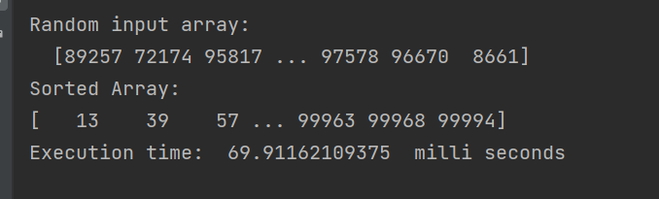
When the input data is in random order (Average Case):

Slide 12
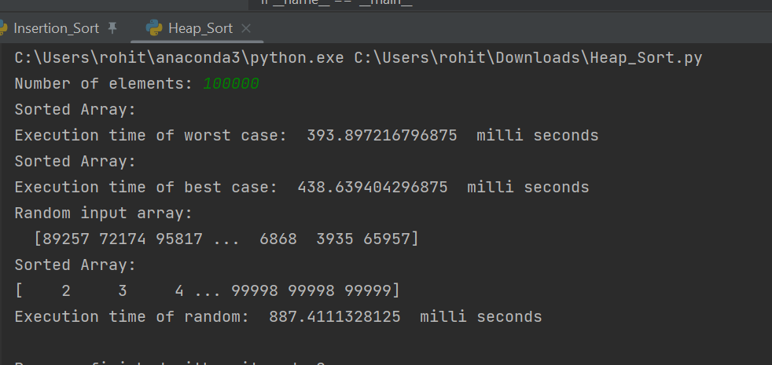
3) For Large Input Length (100000)

Slide 13
Average Time Of Execution
For small input (500), the average time of execution is 1.50 milli seconds.
For medium input (10000), the average time of execution is 45.16 milli seconds.
For large input (100000), the average time of execution is 573.31 milli seconds.

Slide 14
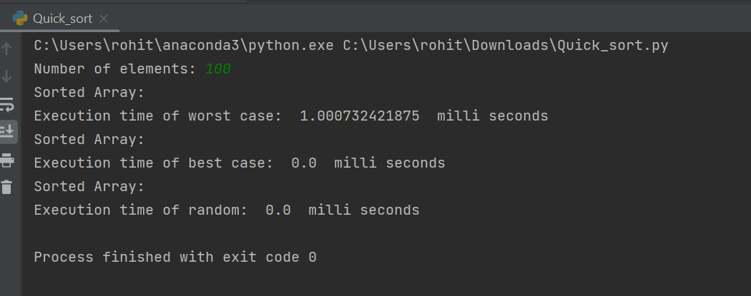
Quick sort
1) For Small Input Length (100)

Slide 15
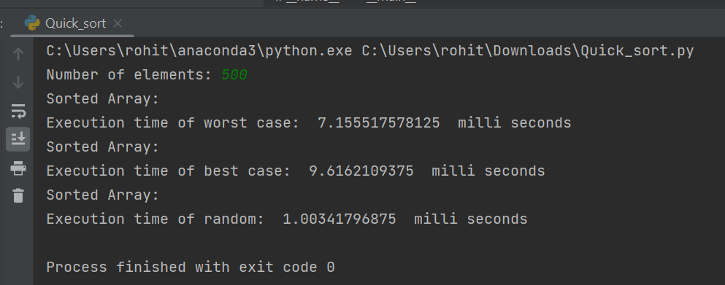
2) For Medium Input Length (500)

Slide 16
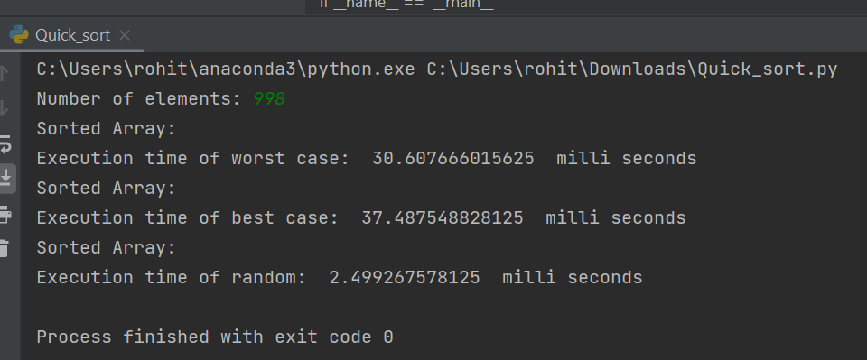
3) For Large Input Length (998)

Slide 17
Average Time Of Execution
For small input (100), the average time of execution is 1.00 milli seconds.
For medium input (500), the average time of execution is 5.92 milli seconds.
For large input (998), the average time of execution is 23.53 milli seconds.

Slide 18
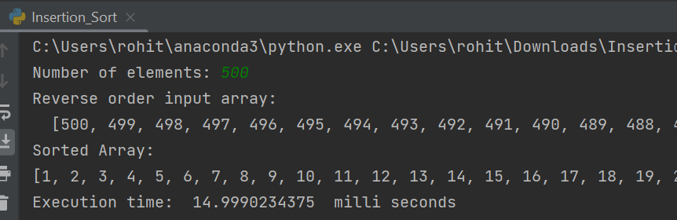
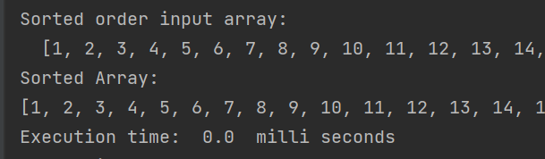
Insertion sort
1) For Small Input Length (500)
When the input data is in reverse sorted order (Worst Case):
When the input data is in sorted order (Best case):

Slide 19
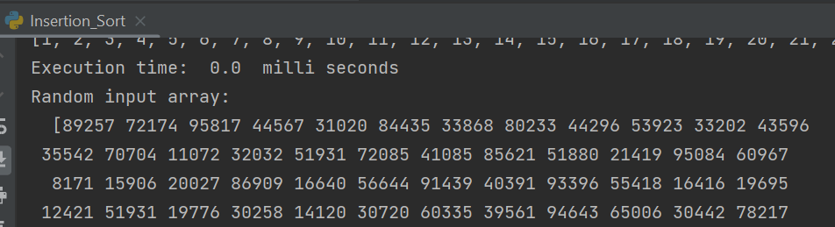
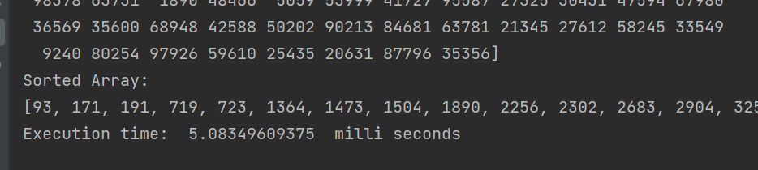
When the input data is in random order (Average Case):

Slide 20
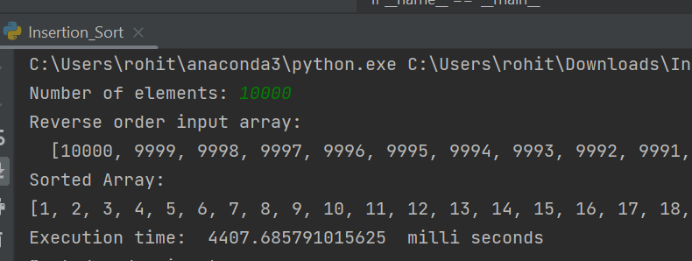
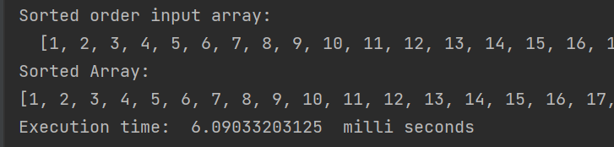
2) For Medium Input Length (10000)
When the input data is in reverse sorted order (Worst Case):
When the input data is in sorted order (Best case):

Slide 21
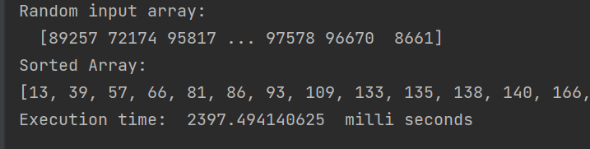
When the input data is in random order (Average Case):

Slide 22
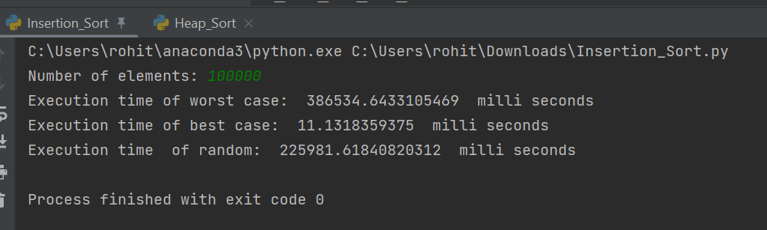
3) For Large Input Length (100000)

Slide 23
Average Time Of Execution
For small input (500), the average time of execution is 6.66 milli seconds.
For medium input (10000), the average time of execution is 2270 milli seconds.
For large input (100000), the average time of execution is 204175 milli seconds.

Slide 24
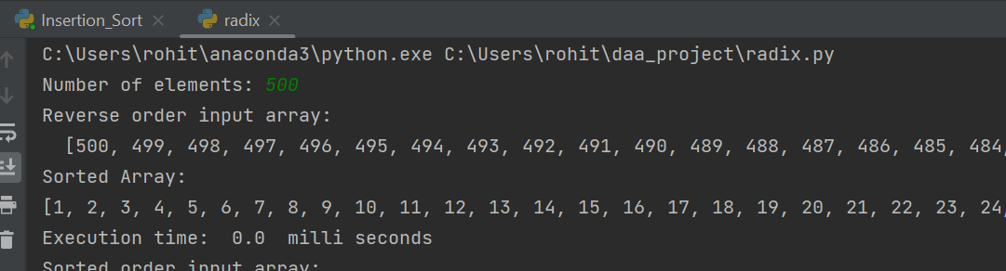
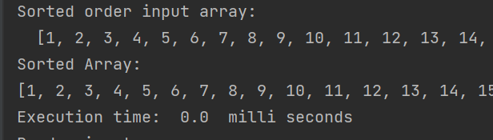
Radix sort
1) For Small Input Length (500)
When the input data is in reverse sorted order (Worst Case):
When the input data is in sorted order (Best case):

Slide 25
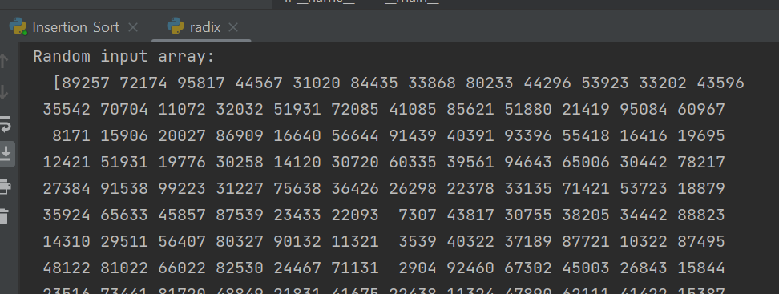
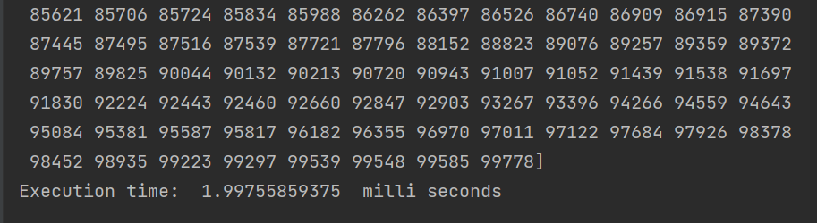
When the input data is in random order (Average Case):

Slide 26
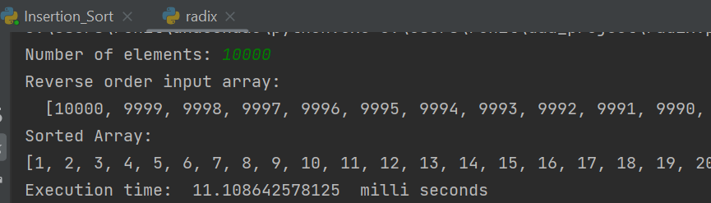
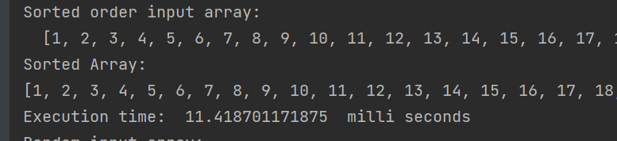
2) For Medium Input Length (10000)
When the input data is in reverse sorted order (Worst Case):
When the input data is in sorted order (Best case):

Slide 27
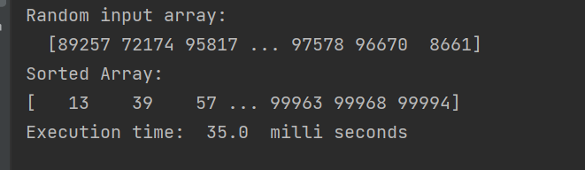
When the input data is in random order (Average Case):

Slide 28
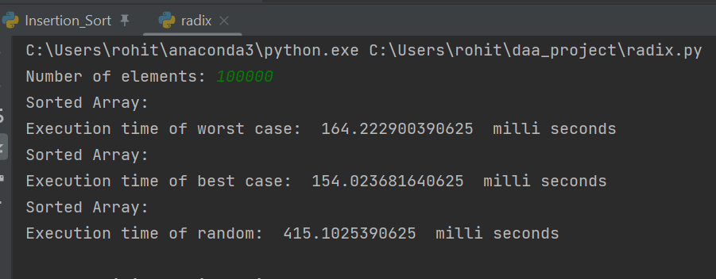
3) For Large Input Length (100000)

Slide 29
Average Time Of Execution
For small input (500), the average time of execution is 0.66 milli seconds.
For medium input (10000), the average time of execution is 19.17 milli seconds.
For large input (100000), the average time of execution is 244.44 milli seconds.

Slide 30
Conclusion
When the input data is small (500) and,
is in reverse order then Radix Sort is better.
is in sorted order then Insertion and Radix sort are better.
is in random order then Quick Sort is better.
When the input data is medium (10000) and,
is in reverse order then Radix Sort is better.
is in sorted order then Insertion Sort is better.
is in random order then Quick Sort is better.

Slide 31
When the input data is large (100000) and,
is in reverse order then Radix Sort is better.
is in sorted order then Insertion Sort is better.
is in random order then Quick Sort is better.

